Slide 1
AN alternative approach to FIRST LEGO LEGUE ROBOTS: Guidelines for a COMPETITION ROBOT
HOTSHOT HOTWIRES

Slide 2
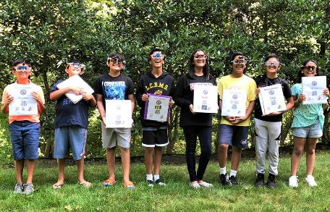
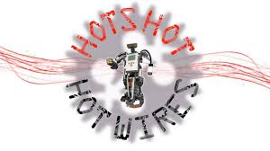
About the Author
The Hotshot Hotwires is a community-based FIRST LEGO League team in the mid Hudson Valley region of New York.
The team started in 2012, although all of the original coaches and students have graduated.
The photograph is of our 2018-19 team, comprised of 5th-8th graders.

Slide 3
OBJECTIVES
Learn to build simple robots, which have minimum attachments, and perform reasonably well in competitions

Slide 4
4 main components of a mission-ready robot
Mobility Mechanisms
Body
Sensors
Actuators:
Active and Passive

Slide 5
MOBILITY MECHANISMS
Driving mechanism
Drive wheels + motors
Evaluate traction and size of drive wheels
Two-point contact for drive axles
Steering
Rear wheels/coasters - these can affect steering
Software
Gyro sensor input necessary for moving straight reliably, and for accurate turns

Slide 6
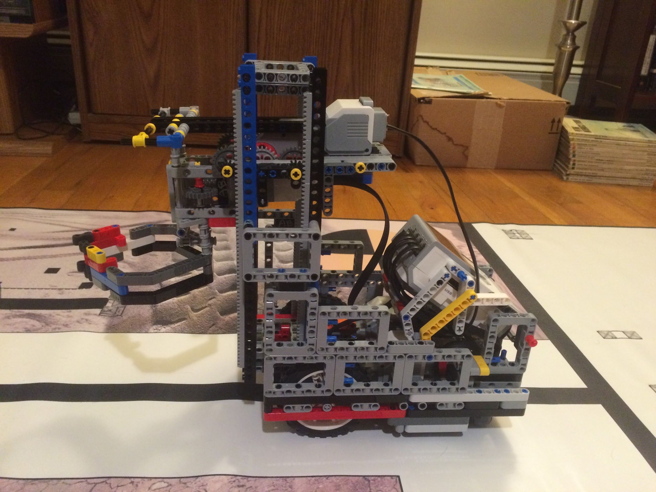
BODY
Size (must consider the field and missions).
Sturdy structure - use frame pieces and L-beams
Appropriate center of mass (between front and rear axles, but closer to the drive axle for good traction)
Easy access to brick buttons, all ports, charging port, and battery compartment
Provision for attachments (minimize attachment change)

Slide 7
SENSORS
Light/color and gyroscopic sensors are most useful
The EV3 ultrasonic sensor is not super accurate, but worth experimenting with for certain applications
Remember: all four motors can also be used as sensors
Since motors can detect obstacles, generally the touch sensors can be avoided
Sensors must be connected firmly - no wobble (to ensure consistency)

Slide 8
ATTACHMENTS/Actuators
Attachments are what you add to your robot
Actuators are the tool you use to complete the task
Actuators can be active (have power source) or passive (no power)
Actuators can be simple (perform one task) or compound (perform more than one task)
Strive to minimize attachment changes during robot game – try to make the actuators as general purpose as possible for a given season
There could be many great ways for solving each mission. Think of ways of sharing motions, and therefore, actuators between missions.

Slide 9
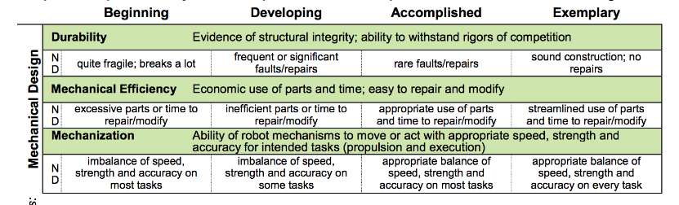
Simplicity and Minimalism in Design
Simplicity and minimalism are well-respected design principles.
Build the simplest robot/attachments with as few parts as possible that you think will do the job.
If things don’t work (and they often won’t), then try solving the problem with smarter programs first.
Add more parts only as a last resort.

Slide 10
Credits
This tutorial was created by Hotshot Hotwires
Facebook Page: https://www.facebook.com/hotshothotwires/
YouTube Channel: https://www.youtube.com/channel/UCC2U3CBy-QD1Dr09WZRx2Ug
Contact us at hotshothotwire@gmail.com or l_nino@yahoo.com
More lessons at www.ev3lessons.com and www.flltutorials.com
This work is licensed under a Creative Commons Attribution-NonCommercial-ShareAlike 4.0 International License.

